Slide 1



Humanoid Research Software Development Platform
Christopher T. Cannon (ctc82@drexel.edu)
Jeffrey Segall (js572@drexel.edu)
William C. Regli (regli@drexel.edu)
Youngmoo Kim (yek23@drexel.edu)

Slide 2
Problem Statement and Goals
Problem: A standard platform does not exist to develop humanoid robots.
Difficult to compare performance and effectiveness across implementations.
Goals:
Create a realistic simulation environment;
Deploy robot code to multiple sources (e.g., simulation, miniature robot, full-size robot); and
Utilize open source software.

Slide 3







Project Background: MRI-R²
Project funding from the NSF.
Develop a new common research platform (HUBO+) for the world’s first homogeneous full-sized humanoid team.
Drexel leads the project and we have partnered with:

Slide 4
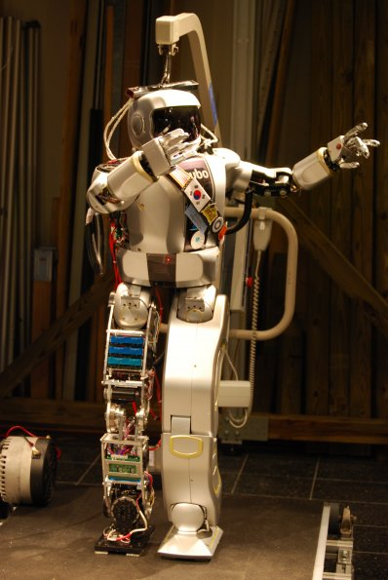
Project Background: Conductor
Conductor is software developed by a master’s student designed to operate with Jaemi HUBO.
Jaemi HUBO is the first humanoid robot Drexel received for research.
Conductor provides:
A simulation environment in Webots to test robot code;
A method to output robot code to a miniature humanoid robot; and
A method to output robot code to the Jaemi Hubo.
Jaemi HUBO

Slide 5
Software Platform Goals
Goal: Adapt Conductor to work with HUBO+.
Utilize only open source software for all components of the system (e.g., simulator, communication, etc.).
Provide a common interface to the software that robotics developers are already familiar with.
Output to multiple environments.

Slide 6
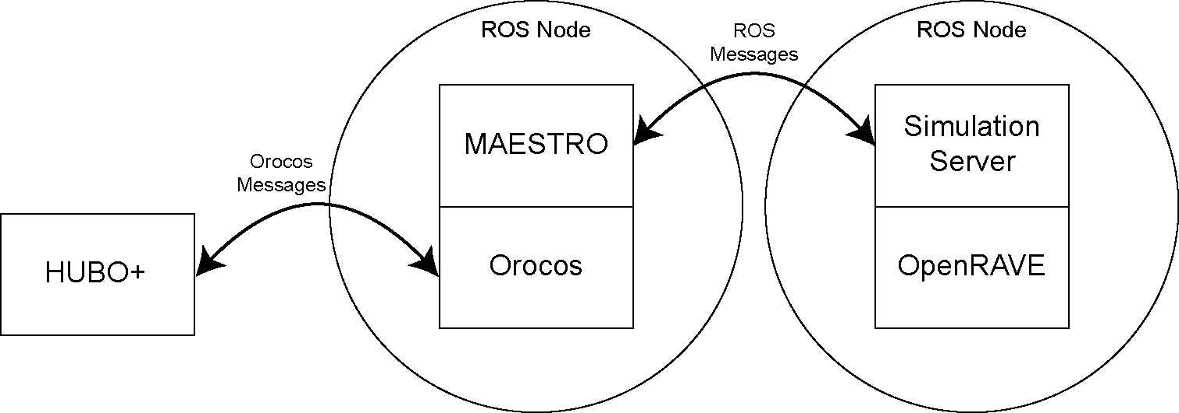
MAESTRO
MAchine and Environment Software Translation to Ros (MAESTRO)
MAESTRO uses all open-source technologies:
Orocos for real-time communication;
ROS for its extensive list of supported software and devices.
OpenRAVE to simulate HUBO+ operations.
MAESTRO uses the ROS framework to provide a generic interface that is widely adopted by robotics developers.
MAESTRO is designed to output to simulation environments and hardware.
MAESTRO software architecture.

Slide 7
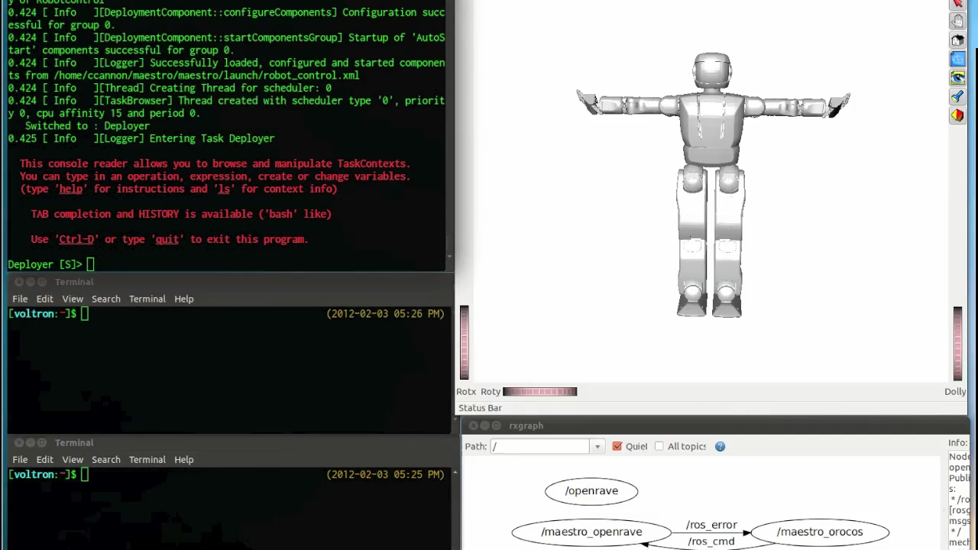

Slide 8
Future Work
Short-term work:
Operate a single motor test rig.
Operate the basic functions of HUBO+.
Long-term work:
Integrate power usage statistics that model power consumption.
Integrate the SimLab simulation environment to provide advanced robot physics.

Slide 9
Thank you for your time and attention.
Christopher T. Cannon (ctc82@drexel.edu)
Jeffrey Segall (js572@drexel.edu)
William C. Regli (regli@drexel.edu)
Youngmoo Kim (yek23@drexel.edu)

